Slide 1
Workshop 6 & 10
Platform Trials/Response Adaptive Trials:
Overview of Design Elements
2024 New Investigators Clinical Trial Course
Laura Pearce, MS, BScH
Executive Director, Cell Therapies
Senior Investigator, Investigational New Drug Program, CCTG

Slide 2
Conflict of Interest Statement
Shareholder GSK
Former GSK employee (within last 2 years)

Slide 3
Objectives/Outline
1. Define platform trials and adaptive trials
2. Describe the key design elements of and rationale for these types of trials
3. Identify associated operational and logistical needs, benefits and challenges

Slide 5
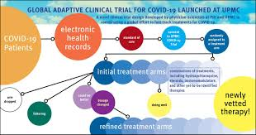
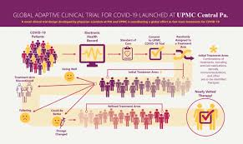
Platform & Adaptive Trials Are Not New…

Slide 6
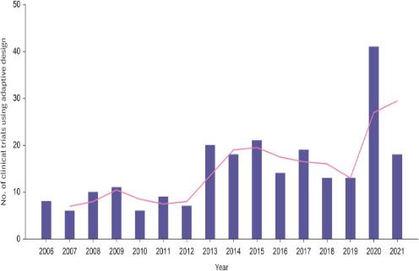
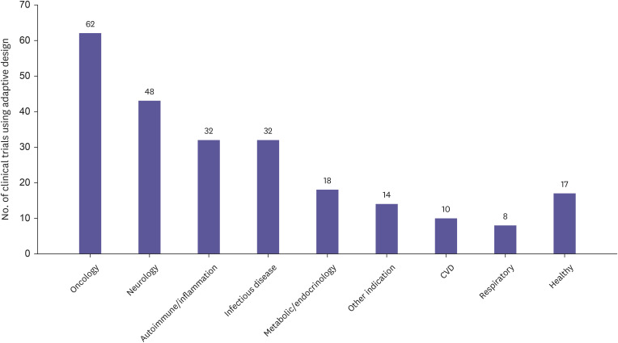
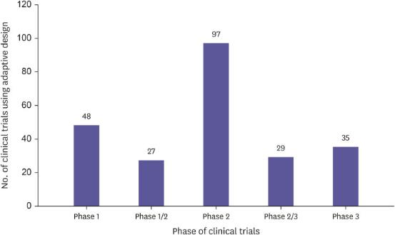
And Use Is Increasing
Transl Clin Pharmacol. 2023 Dec; 31(4): 202–216.
Published online 2023 Dec 21. doi: 10.12793/tcp.2023.31.e21
Notes:
Transl Clin Pharmacol. 2023 Dec; 31(4): 202–216.
Published online 2023 Dec 21. doi: 10.12793/tcp.2023.31.e21

Slide 7
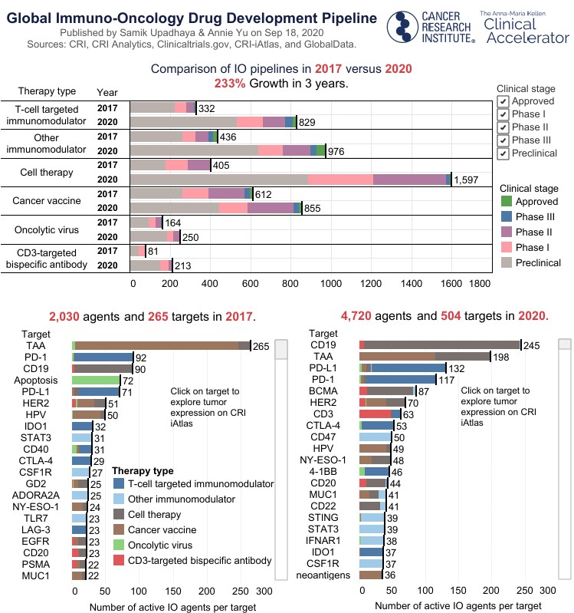
Why?
Research questions for which traditional parallel-group trials too difficult and costly
Comparing multiple interventions
Generating separate effect estimates across subgroups of patients with distinct but related conditions
Minimize time (between trials)
Minimize cost
Pandemic emphasized:
the need for very rapid evidence generation;
limited data to guide sample size determination;
disease heterogeneity + possibility for heterogeneous treatment effects;
varying clinician levels of comfort randomly assigning patients versus empirically implementing treatments;
Desire to study (and preferentially randomly assign each patient to) multiple, potentially interacting treatments concurrently,
minimize the number of nontreated control subjects (and pts receiving ineffective treatment;
desire to create durable infrastructure for evidence evaluation
CRI Tableau Public; accessed 20AUG24; and Nature Reviews Drug Discovery 19, 751-752 (2020)
doi: https://doi.org/10.1038/d41573-020-00166-1

Slide 8
Clinical Trial Designs
The Adaptive Platform Trials Coalition Nat Rev Drug Discovery 2019

Slide 9
Master Protocol Trial Designs
Master protocol: Main protocol designed to evaluate multiple interventional hypotheses with standardized elements
supplemented with intervention-specific appendixes, other protocol-related appendixes or substudies
common theme / linker
Basket
Single therapy
Multiple diseases (common factor)
Umbrella
Single disease
Multiple targeted therapies
Platform
Single disease
‘Perpetual’ therapies
The Adaptive Platform Trials Coalition Nat Rev Drug Discovery 2019

Slide 10
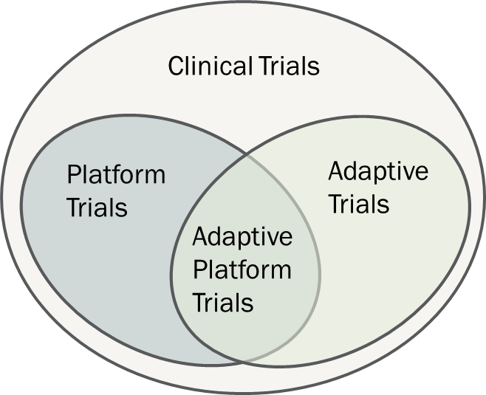
Master Protocol Trial Designs
Adaptive trial design: Trial design evolves as information accrues according to prespecified rules and interim analyses according to prespecified schedules.
Platform trial design:
A trial design in which multiple interventions can be evaluated over time AND interventions can come and go.
Implies use of a master protocol
Adaptive Platform:
Intersection of these two designs; multiple interventions in a disease or condition in a perpetual manner, with interventions entering and leaving the platform on the basis of a predefined decision algorithm
The Adaptive Platform Trials Coalition Nat Rev Drug Discovery 2019
Lawler, P. et. al., Circulation. 2022;145:629–632. DOI: 10.1161/CIRCULATIONAHA.121.058113

Slide 11
Adaptive Platform Trials
Need for efficient trial strategies to evaluate multiple treatments and combinations of treatments, in patient populations over time.
Efficiencies:
Concurrent control arm with multiple investigational interventions
Interim accumulating data
Regulatory
Ethical
Operational
Challenges:
long-term commitment of resources, personnel
Operational
Study sites
Accrual
Maintaining active arms
Data management/ analysis

Slide 12
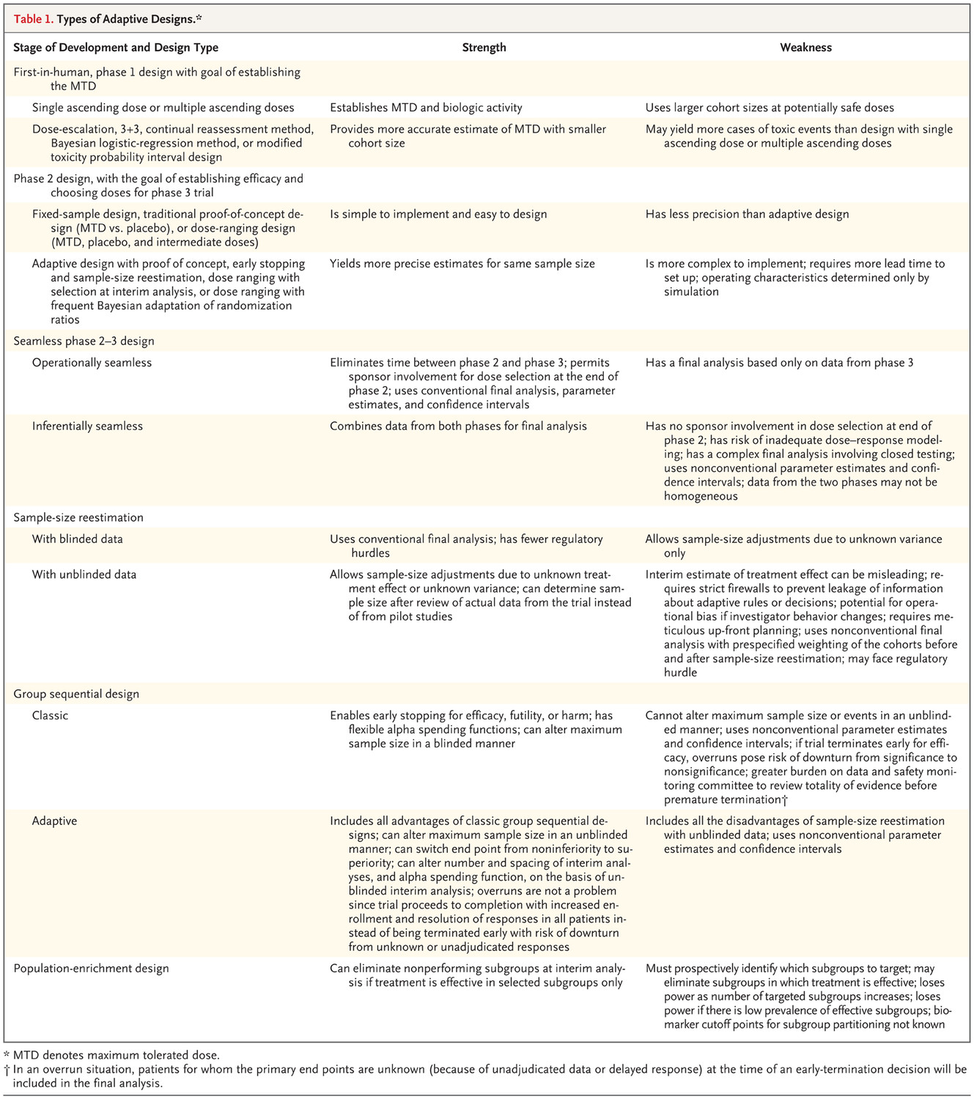
Adaptive Designs
Bhatt DL﻿, Mehta C﻿. Adaptive designs for clinical trials. ﻿ N Engl J Med. 2016;375(1):65-74.

Slide 13
Adaptive Designs
Trial adaption, and cited examples of use | Type of adaptive design (AD) and examples statistical methods
Changing the predetermined sample size in response to inaccurate assumptions of study design parameters to achieve the desired statistical power [34,35,36]. | Sample size re-estimation(SSR) using aggregated interim data from all participants or interim data separated according to allocated treatment [37,38,39,40,41,42,43,44].
Stopping the trial early for efficacy, futility, or safety when there is sufficient evidence [45, 46]. | Group sequential design (GSD) [47, 48]; [49]; futility assessment using stochastic curtailment [50,51,52].
Evaluating multiple treatments in one trial allowing for early selection of promising treatments or dropping futile or unsafe treatments [53,54,55] and add to ongoing trial [56]. | Multi-arm multi-stage (MAMS), dose/treatment-selection, drop-the-loser, or pick-the-winner, or add arm [23, 57,58,59,60,61,62,63,64,65,66].
Changing the treatment allocation ratio to favour treatments indicating beneficial effects [67, 68]. | Response-adaptive randomisation (RAR) [68,69,70,71,72,73].
IMultiple trial phases, in one trial under a single protocol [74,75,76]. | Operationally or inferentially seamless AD [63,64,65, 77,78,79].
Adjusting the trial population or selecting patients with certain characteristics that are most likely to benefit from investigative treatments [80,81,82,83].. | Population or patient enrichment or biomarker AD [84,85,86,87,88].
Changing the primary research hypotheses or objectives or primary endpoints [78, 89]. For example, switching from non-inferiority to superiority. | Adaptive hypotheses [58, 90].
Switching the allocated treatment of patients to an alternative treatment influenced by ethical considerations, for instance, due to lack of benefit or safety issues. | Adaptive treatment-switching [91, 92].
Combination of at least two types of adaptations [24, 36, 89, 93,94,95,96,97,98]. | Multiple [99]; inferentially seamless phase 2/3 [77] or population enrichment [100]; biomarker-stratified with RAR [101]; adaptive platform trials [19, 24, 102].
Dimairo, M., et al. Trials 21, 528 (2020). https://doi.org/10.1186/s13063-020-04334-x

Slide 14
Adaptive Trial Design – What Adaptations?
Allows assessment of response to treatment while the study is running
Can incorporate findings from within or outside the trial
Eligibility
Biomarker information
Treatments
Endpoints
Randomization
This allows the trial to stay current with the latest updates

Slide 15
Platform Trial - Randomized
Park JHJ et al. J Clin Epi 125: 1-8, 2020. https://doi.org/10.1016/j.jclinepi.2020.04.025

Slide 16
Platform Design – Randomized Response Adaptive
Patrick R. Lawler. Circulation. 145, Issue: 9, Pages: 629-632, DOI: (10.1161/CIRCULATIONAHA.121.058113)

Slide 17
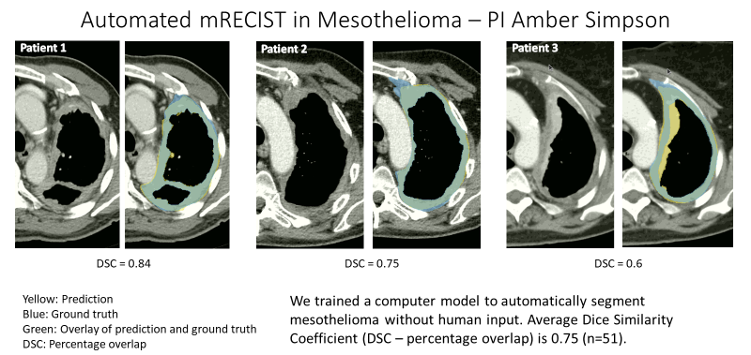
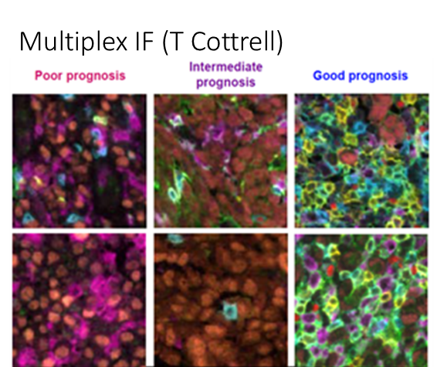
NCT02784171
Q Chu (CCTG), F Perrone (NCI-N), L Greillier (IFCT), L Seymour, D Tu, C Lee, N Leighl
M Tsao, S Lantejoul T Cottrell
Adaptive design phase 2/3
IND.227 A Phase II/III Randomized Trial of Pembrolizumab in Advanced Malignant Pleural Mesothelioma
Phase II – Canada, Italy
Primary Endpoint – Progression Free Survival
Phase III – Canada, Italy, France
Primary Objective: Overall Survival
Primary Endpoint For IA – CR, PR, SD at 16 weeks
Secondary Objectives:
Efficacy, Safety
HrQoL (Lee)
Economics (Leighl)
Tumour PDL, IC (Tsao)
Exploratory Objectives:
Prognostic & Predictive Markers
Post IA
Cisplatin Pemetrexed
Cisplatin Pemetrexed
Patients with uunresectable or metastatic MPM
Cisplatin
Pemetrexed Pembrolizumab
Cisplatin
Pemetrexed Pembrolizumab
Pembrolizumab
X

Slide 18
I240 Trial - Immunotherapy Platform Study in Platinum Resistant High Grade Serous Ovarian Cancer (IPROC) NCT04918186
Patients’ archive sample will be screened for AXL and ROR2 expression
Patients will be enrolled based on marker results
If enrolment could be into more than 1 cohort, then patient will be randomized
Patient with HGSO
Substudy A
Durvalumab+BA3011
Substudy B
Durvalumab+BA3021
Substudy C (etc.)
to be decided
Screening registration
Stage 1
enroll 10 pts
Stage 1
enroll 10 pts
Stage 1
enroll 10 pts
Only stage 1 substudies open - biomarker assay after enrollment
At least 1 stage 2 substudy open - biomarker assay prior to enrollment
if response in stage 1 enroll 10 additional pts
(enrich if indicated)
if response in stage 1 enroll 10 additional pts
(enrich if indicated)
if response in stage 1 enroll 10 additional pts
(enrich if indicated)
Pt enrolled to open substudy; if more than one open - randomize
Positive - enroll to applicable substudy - if > 1 relevant biomarker, trial committee assigns
Negative - enroll to available substudy; if more than one then randomize

Slide 19
KEYNOTE (KN-001): Pembrolizumab Trial
Phase I in “advanced solid tumors” (n=40)
Showed high efficacy in melanoma
Added expansion cohorts:
Non–small cell lung cancer
Testing lower doses in NSCLC and melanoma
To provide training and validation sets for the PD-L1 biomarker expression test
More disease cohorts were added as more information was collected
Incorporated aspects of:
Basket trial design: different diseases
Umbrella trial design: biomarker variability, variable prior therapies within disease cohorts
Adaptive trial design: additional cohorts, different dosing
Ultimately enrolled 1260 patients
FDA approval (melanoma) 3.5 years after study initiation without a randomized, controlled trial
Other data from the study has led to approval in NSCLC, head and neck cancer, Hodgkin lymphoma, urothelial carcinoma, MSI-high cancer, and gastric cancer

Slide 20
KN-001: Pembrolizumab Seamless Design Study

Slide 21
Risk of Bias in Platform Trials
Prespecified plans for interim and statistical analyses used in the trial
Prespecified plans applied equally to all interventions
Concurrent/nonconcurrent randomized participants for statistical comparisons
Information flow/results
IDSC, Trial Committee, Participants
Follow reporting guidelines in publications

Slide 22
Nonconcurrent Randomization Bias the Results
Dodd L, Friedlin, B. N Engl J Med 2021; 384:1572-1573. DOI: 10.1056/NEJMc2102446

Slide 23
Platform Trial Design (MAMS) – STAMPEDE
Addition of docetaxel, zoledronic acid, or both to first-line long-term hormone therapy in prostate cancer (STAMPEDE)

Slide 24
STAMPEDE Trial:
Advanced Prostate
Outcomes:
Pilot: toxicity
Stage I: PFS (HR ≤ 0.75)
Stage II: PFS (HR ≤ 0.75)
Stage III: PFS (HR ≤ 0.75)
Stage IV: OS (HR ≤ 0.75)
Overall analysis: pairwise with multiple comparisons correction (p
< 0.017)

Slide 25
Platform Trial – STAMPEDE Addition of docetaxel, zoledronic acid, or both to first-line long-term hormone therapy in prostate cancer (STAMPEDE)
Figure 1
James ND et al. The Lancet 2016 3871163-1177DOI: (10.1016/S0140-6736(15)01037-5)

Slide 26
Trial Management
Hague, D., et al. Trials 20, 294 (2019). https://doi.org/10.1186/s13063-019-3322-7
Notes:
Hague, D., et al. Changing platforms without stopping the train: experiences of data management and data management systems when adapting platform protocols by adding and closing comparisons. Trials 20, 294 (2019). https://doi.org/10.1186/s13063-019-3322-7

Slide 27
Summary - Traditional and Platform Trials
Or therapeutic intervention in a defined population)
(optional)
for funding or drug supply
Berry SM et al. JAMA. 2015;313(16):1619-1620. doi:10.1001/jama.2015.2316

Slide 28
Key Considerations: Preplan and Prespecify
Selection criteria of new research questions & interventions
Clinical leadership
Scientific peer review
Funding/sustainability
Biomarker development and cohort selection
Investigator/site engagement & feasibility of accrual
Protocol development and amendments (timing)
Ethics and regulatory assessment and version control
Clear terminology
Contracts and drug supply
CRFs and database changes
Site implementation
Trial management priorities
New, ongoing, IA

Slide 29
Key Messages
Adaptive platform and umbrella protocols offer several practicable and desirable benefits which facilitate speedier answers and allow clinical trials to serve as a tool to move treatment on for patients much more quickly.
The use of shared resources across multiple comparisons must be cost-saving compared to separate two-arm non-adaptive trials to address the same questions.
There are notable design, operational and logistical challenges which require careful attention.

Slide 30
References
Angus DC﻿, Alexander BM﻿, Berry S﻿, et al; Adaptive Platform Trials Coalition. Adaptive platform trials: definition, design, conduct and reporting considerations. ﻿ Nat Rev Drug Discov. 2019;18(10):797-807. doi:10.1038/s41573-019-0034-3
Barker AD﻿, Sigman CC﻿, Kelloff GJ﻿, Hylton NM﻿, Berry DA﻿, Esserman LJ﻿. I-SPY 2: an adaptive breast cancer trial design in the setting of neoadjuvant chemotherapy. ﻿ Clin Pharmacol Ther. 2009;86(1):97-100. doi:10.1038/clpt.2009.68
Bhatt DL﻿, Mehta C﻿. Adaptive designs for clinical trials. ﻿ N Engl J Med. 2016;375(1):65-74.
Hague D,, et al. Changing platforms without stopping the train: experiences of data management and data management systems when adapting platform protocols by adding and closing comparisons. Trials. 2019. https://doi.org/10.1186/s13063-019-3322-7
Lawler, P.R., et al. What are adaptive platform clinical trials and what role may they have in cardiovascular medicine? Circulation. 2022; 1 45:629-632. doi: 10.1161/Circulationaha.121.058113
Lee, H., et al. Adaptive design clinical trials: current status by disease and trial phase in various perspectives. Transl Clin Pharmacol. 2023 (Dec); 31(4): 202-216. doi:10.12793/tcp.2023.31.e21
Master Protocols: Efficient Clinical Trial Design Strategies to Expedite Development of Oncology Drugs and Biologics. FDA Guidance for Industry. https://www.fda.gov/media/120721/download
Meyer, E.L., et al. Systematic review of available software for multi-arm multi-stage and platform clinical trial design. Trials 22, 183 (2021). https://doi.org/10.1186/s13063-021-05130-x
Park JJH﻿, Siden E﻿, Zoratti MJ﻿, et al. Systematic review of basket trials, umbrella trials, and platform trials: a landscape analysis of master protocols. ﻿ Trials. 2019;20(1):572. doi:10.1186/s13063-019-3664-1
Saville BR﻿, Connor JT﻿, Ayers GD﻿, Alvarez J﻿. The utility of bayesian predictive probabilities for interim monitoring of clinical trials. ﻿ Clin Trials. 2014;11(4):485-493. doi:10.1177/1740774514531352
Schiavone, F., Bathia, R., Letchemanan, K. et al. This is a platform alteration: a trial management perspective on the operational aspects of adaptive and platform and umbrella protocols. Trials 20, 264 (2019). https://doi.org/10.1186/s13063-019-3216-8
Sydes MR﻿, Parmar MKB﻿, Mason MD﻿, et al. Flexible trial design in practice—stopping arms for lack-of-benefit and adding research arms mid-trial in STAMPEDE: a multi-arm multi-stage randomized controlled trial. ﻿ Trials. 2012;13:168. doi:10.1186/1745-6215-13-168
Sydes MR﻿, Spears MR﻿, Mason MD﻿, et al; STAMPEDE Investigators. Adding abiraterone or docetaxel to long-term hormone therapy for prostate cancer: directly randomised data from the STAMPEDE multi-arm, multi-stage platform protocol. ﻿ Ann Oncol. 2018;29(5):1235-1248. doi:10.1093/annonc/mdy072
Woodcock J﻿, LaVange LM﻿. Master protocols to study multiple therapies, multiple diseases, or both. ﻿ N Engl J Med. 2017;377(1):62-70. doi:10.1056/NEJMra1510062

Slide 31
Extra Slides

Slide 32
Platform Trials – Logistics and Operations
Area | Proposed Approach
Research question | Define criteria for review of new interventions
Trial Management Group | Collaborative Group
 | Study chair/principal investigator: overall trial oversight
 | Co-chairs/PIs: clinical and scientific leadership for addition of new trial interventions
Scientific peer review | Ongoing discussion with key funding stakeholders/partners
 | Planning for adequate support of central and site resources
 | Addition of new comparison discussed in early stages to assess feasibility of funding
Biomarker | Clearly define cohort and identify biomarkers, assure feasibility and laboratory QC
Protocol | Consider futureproof changes in trial design (e.g. modular)
Ethics/Regulatory approval | Rationale for addition of new interventions discussed early with regulatory bodies
CRF and database | Timelines for implementing changes are key for timely implementation
Site implementation | Engage early (e.g. via survey) to gauge interest in new research question
 | Discuss activation criteria with centres
 | Pre-set timelines for local approval of new comparison (if control arm is shared)
Other | Constant assessment of priorities and competing tasks (e.g. new, ongoing versus interim analysis tasks) Importance of adequate resourcing for trial management team
Adapted Schiavone, F, et al. Trials 20, 264 (2019). https://doi.org/10.1186/s13063-019-3216-8

